Slide 1
Tech Just-in-time Job Search
Annie Marra
Assistant Director
February 27, 2017

Slide 2
Agenda
Looking at the Numbers
Johnson hiring data
Beyond the Titans & San Francisco
Tech General Strategy
Basics for tech off-campus
Skills tech cares about
Tech networking tips
Tech Tips & Resources
Industry resources
Pro tips
HTC Resources
Suzie Wong
Key Dates

Slide 3
LOOKING AT THE NUMBERS
Johnson hiring data
Beyond the titans and San Francisco

Slide 4
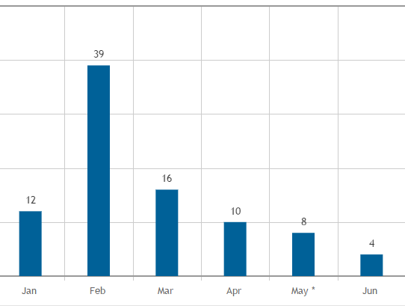
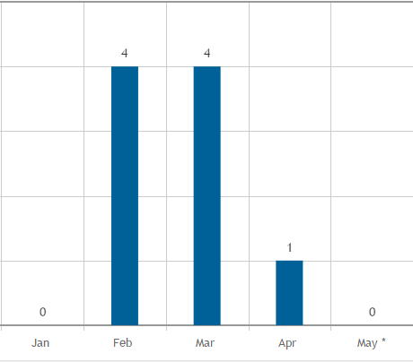
Internship tech industry recruiting trends, 2015-2017
JOHNSON HIRING DATA
Technology
Telecom
*8 offers prior to January
*includes all offers
Distribution of Internship Placement
February – May………………83.8%
February ……………………...43.9%
March – May …………………40.0%
JPAY+, by industry, MBA, Internship, last three years, all offers: excludes sponsored jobs

Slide 5
Internship offering companies, 2015-2017
JOHNSON HIRING DATA
ADP
Amazon
Apple
Applied Materials
AT&T
Autodesk
Bitcasa
Blockchain
Cisco Systems
Comcast
Corning Incorporated
Dell
Digital Lumens
Dish Network
ebay
Ecovative Design
EMC Corporation
Enova International
Google
GoPro
HP
IBM
Intel
Invoice2go
JetBay
Kabam
LinkedIn
Microsoft
Pandora
Pinger
Pitney Bowes
Qualtrics
Recondo
Remind
Rocket Internet
Samsung Electronics
Samsung Telecommunications
SanDisk
Sony
Sprint
Square
Starfish
Startup – unknown
TripAdvisor
Verizon Communications
Verizon Wireless
Vmware
Wayfair
Webtab
Yahoo!
Zillow
ZipZap
Zomato
*darkened companies gave offers March and later, 2015-2017

Slide 6
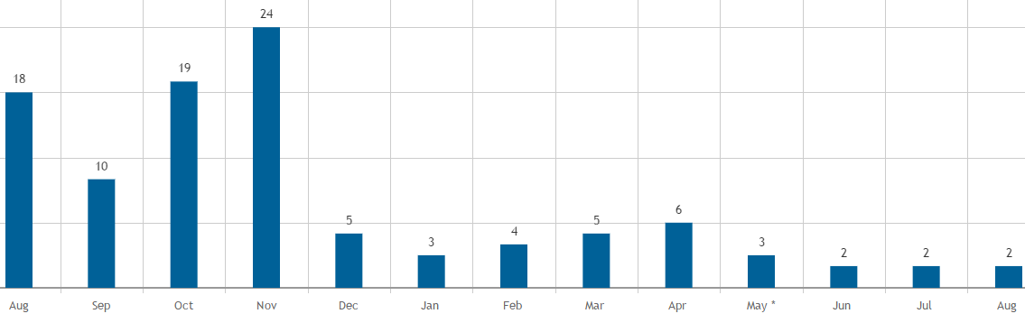
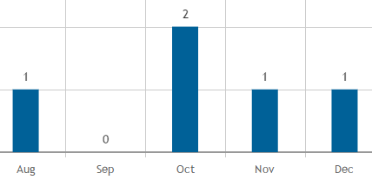
FTE tech industry recruiting trends, 2015-2017
JOHNSON HIRING DATA
Technology
Telecom
Distribution of FTE Placement
August – December ………………75.0%
January – August ………………….25.0%
March – August ……………………19.4%
Graphs JPAY+, industry, MBA (not AMBA), FTE, last three years, all offers: excludes sponsored jobs

Slide 7
FTE offering companies, 2015-2017
JOHNSON HIRING DATA
Alibaba
Amazon
Apple
Assured Testing Services
AT&T
Athena Health
Autodesk
Bridgelux
Cerner Corporation
Cisco Systems
Comcast
Corning Incorporated
Ctrip
Dell
Dish Network
ebay
EMC Corporation
Emerson
Facebook
Fiberspark
Google
HelloFresh
HP
IBM
Microsoft
Intel
LinkedIn
LiveRamp
Microsoft
McKesson
Oracle
Pandora
Pipedrive Inc.
Pitney Bowes
Samsung Electronics
SanDisk
Symantec
TangoMe, Inc.
TapClicks, Inc.
TripAdvisor
Verizon Communications
Verizon Wireless
VMware
Wayfair
Wealthfront
Workday
Yodle, Inc.
*darkened companies gave offers March and later, 2015-2017
Graphs JPAY+, industry, MBA + AMBA, FTE, last three years, all offers: excludes sponsored jobs

Slide 8
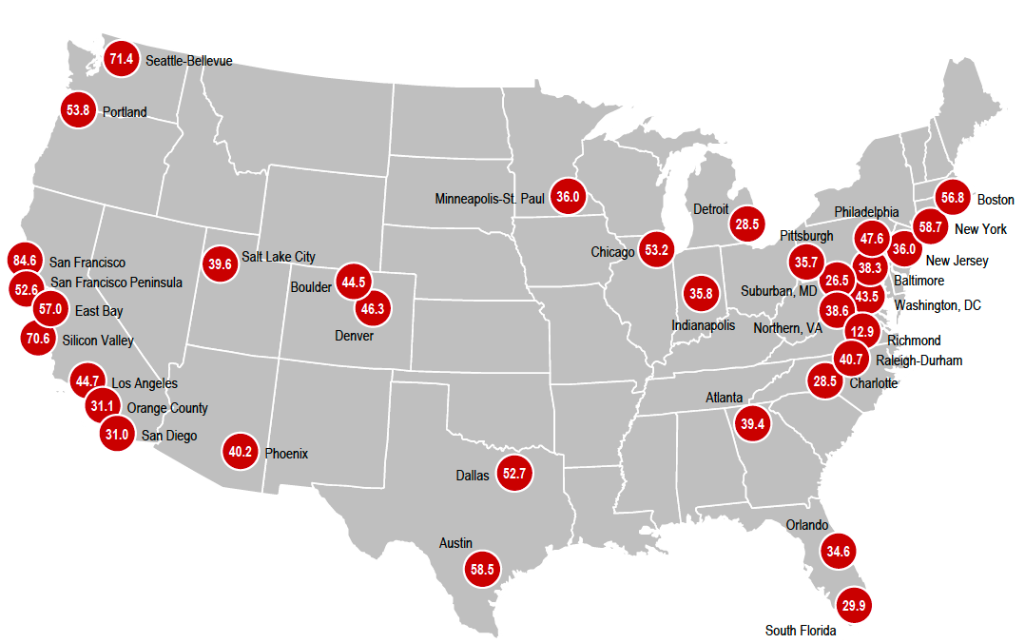
Tech hubs across the United States
BEYOND THE TITANS & SAN FRANCISCO
Detroit
connected cars
Charlotte
fintech
Los Angeles
high tech & entertainment
Indianapolis
STEM
Orlando & South Beach incubators, accelerators, Latin American tech connections
Seattle
#2 tech market in the country
*JLL rates each city against six key economic drivers of high-tech growth: high-tech services concentration, job growth, wage growth, share of U.S. venture capital funding, intellectual capital, innovation and market dynamism which includes transportation and lifestyle factors.
http://www.us.jll.com/united-states/en-us/news/3120/seattle-challenges-norcal-tech-dominance-moves-to-2-market-in-us-for-tech-growth

Slide 9
2015 global startup ecosystem ranking
BEYOND THE TITANS & SAN FRANCISCO
Download the full report here:
http://startup-ecosystem.compass.co/ser2015/
Atlanta, Delhi, Boulder CO, Dublin, Hong Kong, Mumbai, Stockholm, and Waterloo all scored highly
Survey does not include China, Taiwan, Japan or South Korea due to difficulty mining data
http://blog.startupcompass.co/the-2015-global-startup-ecosystem-ranking-is-live

Slide 10
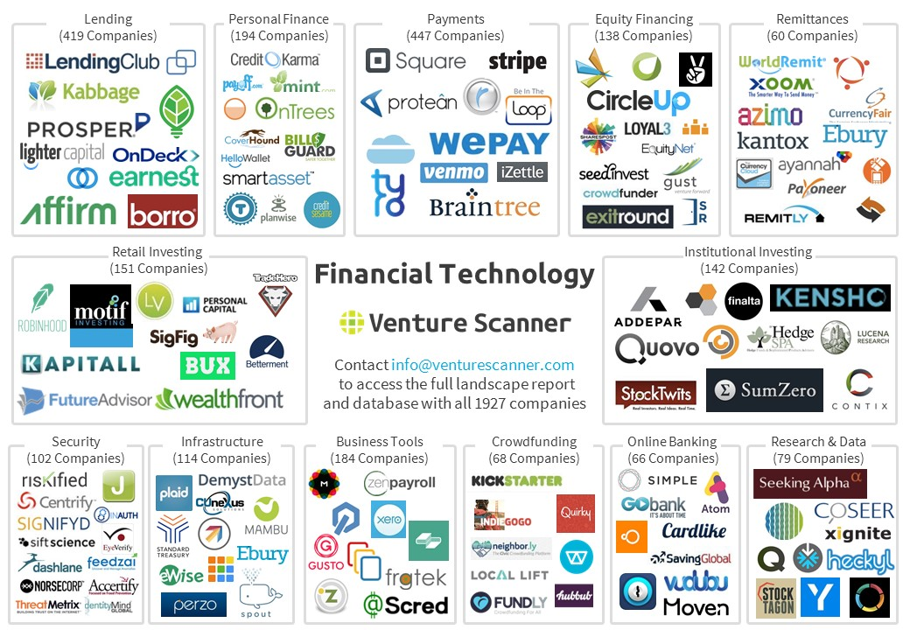
Fin Tech Companies
BEYOND THE TITANS & SAN FRANCISCO
https://www.venturescanner.com/infographics

Slide 11
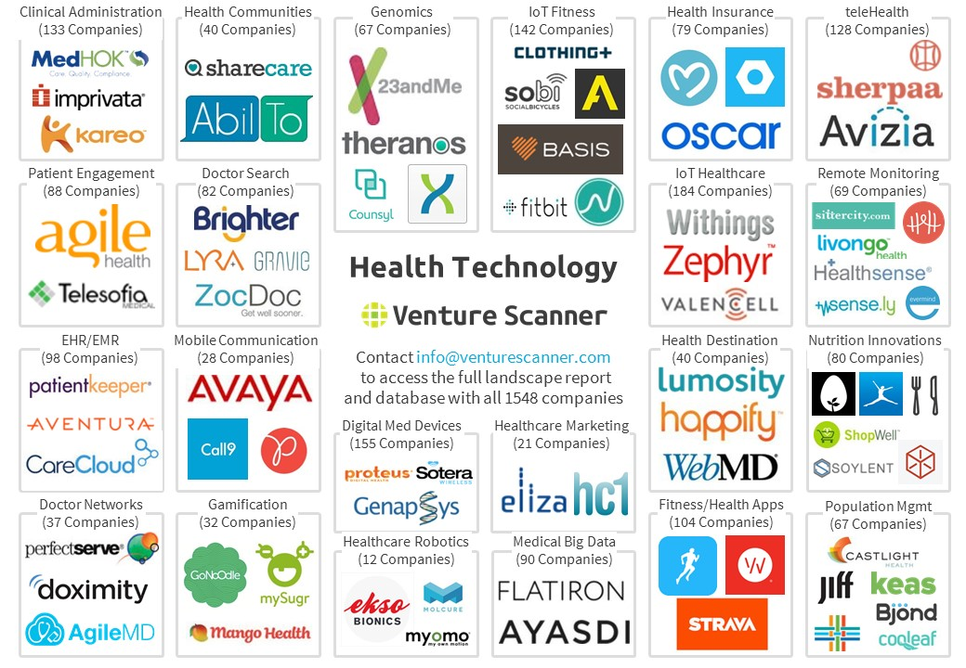
Healthcare Tech
BEYOND THE TITANS & SAN FRANCISCO
https://www.venturescanner.com/infographics

Slide 12
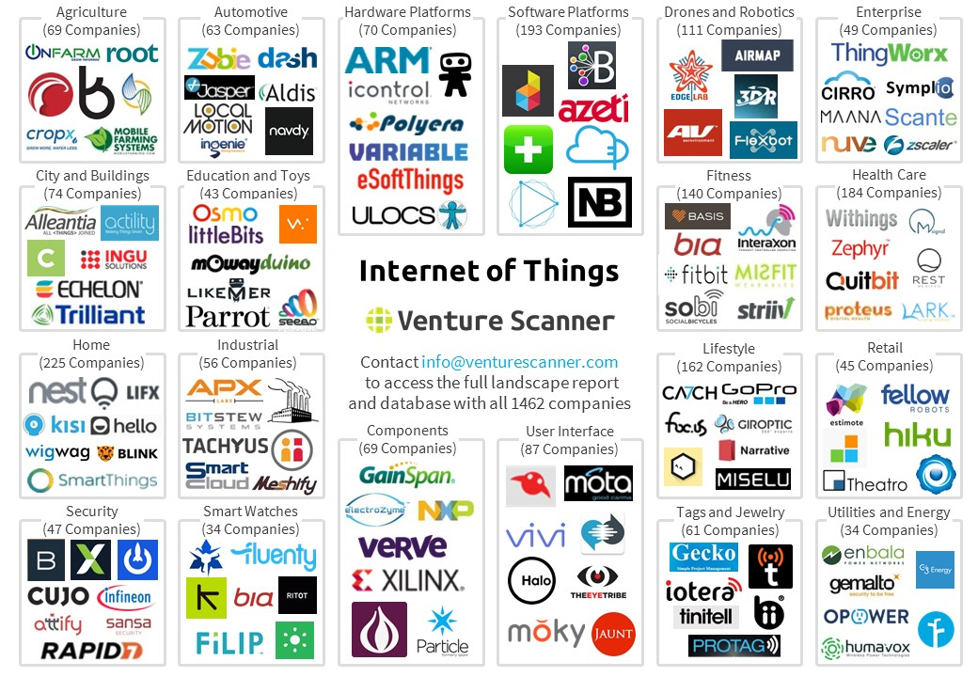
IoT
BEYOND THE TITANS & SAN FRANCISCO
https://www.venturescanner.com/infographics

Slide 13
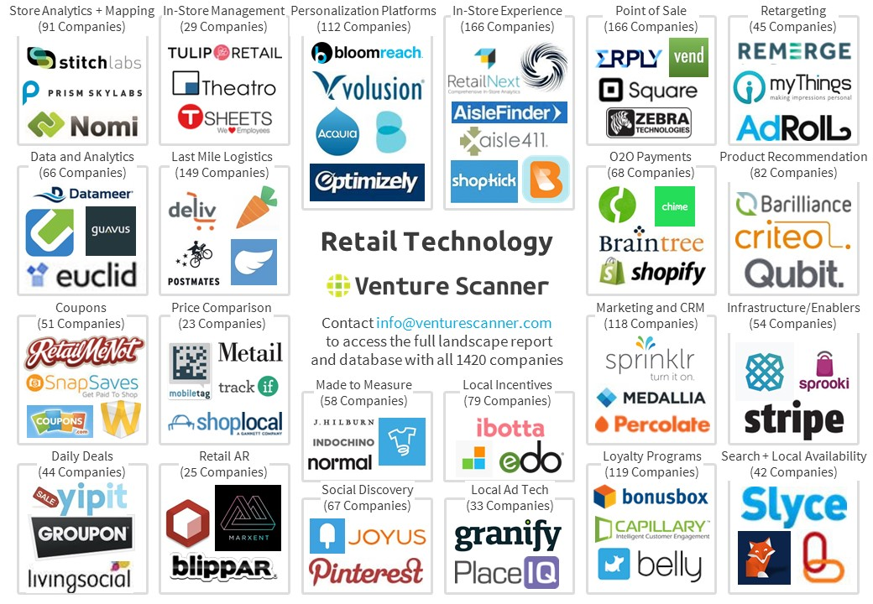
Retail
BEYOND THE TITANS & SAN FRANCISCO
https://www.venturescanner.com/infographics

Slide 14
Moral of the story…

Slide 15
TECH GENERAL STRATEGY
Basics for tech off-campus
Skills tech cares about
Tech networking tips

Slide 16
Make plans – Go places – Visit people
BASICS FOR TECH OFF CAMPUS
Build Your Story
Ask yourself some key questions
What are your goals?
How can you contribute to a specific company? What value will you add?
Prep Materials
Resume, Cover Letter, LinkedIn
Resume & Cover letter
Network & Apply
LAMP, network, find an advocate and apply!
Update your LAMP list:
Referrals
Where do you want to work, and why?
Find advocates
No OCR Companies & 25 employer minimum
Group by industry/theme
LinkedIn, CornellConnect, JConnect
Undergrad or personal contacts
Specific skills: coding, languages, PM
Short-term (internship/break into X)
Long-term (post MBA +2-3 years)
Location
Company type
Either 3-4 days of posting
OR apply first get referral 2nd
Be first to apply
Preliminary scans of talent pool can happen before the due date
CL’s: Discuss your interest in the company (culture, products, location)
Build a case both for the electronic and human scans
LinkedIn
Resume: strong skills focus
Make sure your profile is tech friendly
Tech is likely to look at your LinkedIn
Profile pic can be creative
Highlight areas of interest in your headline/summary
Follow key companies, influencers
Join groups – great way to message for free
Company location
Company size
Type of role
Company culture
Networking tips
Very specific ask in outreach
Be ready to talk in detail about company, position, & products
Add tech friendly key words – compare JD to your resume and CL
Add relevant experiences, even if not professional: side projects, blogs, start-ups, class projects, etc.
Link to blogs, posts, projects
You need to feel like someone who can hit the ground running, not someone who needs time to ramp
Specific experiences: cross-company collaboration, moving the needle forward, new launch of anything, high stakes or high pressure environments

Slide 17
Skills tech cares about
SKILLS TECH CARES ABOUT
Ability to influence and lead
Resilience & tolerance for ambiguity
Strong process skills and detail orientation…but ability to scrap it to get stuff done
Problem solving/removing obstacles for a successful launch & gaining market share
Communication skills
Business judgment and market knowledge
Know your customer needs
Prove your strategy works using data analytics & modeling
Constant cost/benefit analysis
Fluency with + passion for tech
Recent coding skills
Important ONLY for Google/VMWare/etc. & other software heavy companies) and ONLY for Product Management

Slide 18
Tech networking tips - I
TECH NETWORKING TIPS
Networking outreach needs to be targeted and specific: http://goo.gl/R3GAZD
Look for both a recruiter AND a person in your function at each company of interest. They each look at hiring differently & have good, often different advice
Focus on why you wanted to connect with them & what you can offer them too
Try group networking → contacts have been suggesting this to several candidates, it’s still a good look for you!
Identify classmates who share your interests, each pick a company, then ask alum to do a 1:5-person skype call or similar
Sample outreach:
Hi xxx,
Hope you are well!
I am a current Cornell student, focusing on developing my data analytics & strategy skills for a career in product marketing in tech.
I reached out to you as a Cornell alum with a successful career in Tech product marketing, as well as someone who I have common connections with (xxx & xxx). ABC Company has been doing some amazing things with data analytics in the MarTech space, and I’d love to learn more about how you are navigating your career there.
Would you be open to having coffee with me when I’m visiting Boston in 2 weeks? I’m also generally available via phone/Skype MWF from 2-4pm ET.
I really appreciate the advice I’ve received from other alumni in the industry, and look forward to connecting with you. Thanks so much for your time.
Best, your name

Slide 19
Tech networking tips – II
TECH NETWORKING TIPS
Micro-targeting will yield you more qualified results
Targeting of companies/contacts
Tech is ‘logical.’
If your story/pitch/PARs/skills don’t make sense…a contact is less likely to help you
LAMP List strategy is important to help focus outreach efforts
L(Dream), A(Alumni), M(Motivation), P(Posting)
Book is at Management Library with quick start guide in back
Following up
Thank you’s
Be brief, 4-5 sentences
Provide value
Recap your conversation
Provide them a link to an article
Timing
Every 6-8 weeks is plenty to keep the relationship alive
It’s tricky to balance persistent with pestering
Alumni group Links
CornellConnect
Cornell Entrepreneur Network
NYC
Cornell NYC website
Big Red Bulletin for alumni in Metro NYC
Bay Area
Cornell Alumni – Norcal
CAANC-Connect yahoo group
Cornell Silicon Valley (CSV)

Slide 20
TECH TIPS
Industry resources
Pro tips
HTC Resources
Suzie Wong
Key Dates

Slide 21
Must reads
INDUSTRY RESOURCES
To learn re tech or prepare for interviews:
Tech Industry: Wall Street Journal Tech, NY Times Tech, Economist, VentureBeat
Tech Products: Techmeme, Product Hunt, TechCrunch, Re/Code, Wired, Engadget, Mashable, ZDNet, CIO
Industry analyses: CBInsights, Mattermark, VentureScanner (Infographics), FirstMark Capital
PM Interview Prep
http://productcharles.com/
Sample PM interview questions (behavioral)
PM101 (older doc from Google PMs)
Books:
160 PM Questions (Lewis Lin, Teng Lu)
Decode & Conquer (Lewis Lin)
Cracking the PM Interview (Gayle Laakmann McDowell)

Slide 22
PRO TIPS
Pro Tips
Tech doesn’t always value the MBA like other industries
Tech likes to ‘test drive’ people
This is leading to a focus on internship programs and converting interns
University recruiting vs. Just in Time (JIT)
Few tech firms have full-time MBA hiring programs – they lump you in with regular job seekers into ‘just-in-time’ category
Programs = they forecast & ‘hold’ jobs
JIT = they don’t/can’t
Tech wants you to hit the ground running so the right skills and fit are important
Know and market specific skills
Be ready to talk shop
Unstructured industry = unstructured recruiting process = unstructured career progression
Flexibility can provide great opportunities & great challenges
If these are not ideal conditions for you to operate in, Tech may not be for you

Slide 23
PRO TIPS
Roles vs. Demand
Strategy Business Development | Product management Product marketing Corporate marketing Data Analytics/ Market Intelligence/ Business Intelligence | Finance Operations Supply chain/ procurement Sales HR (aka People Operations) Customer Experience
High | Strong | Strong
Low | Moderate | Good
Role(s)
Student Demand
Availability

Slide 24
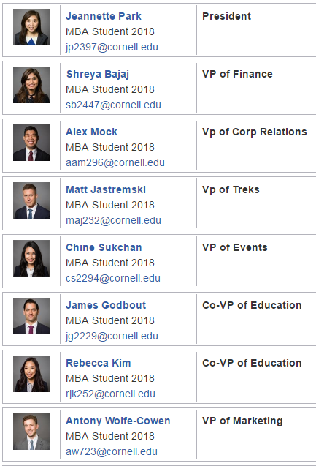
HTC Resources
HTC Resources
HTC Club Resources
PRE: HTC Interview Database
PRE: HTC Interview Guide
POST: HTC Exit Survey

Slide 25
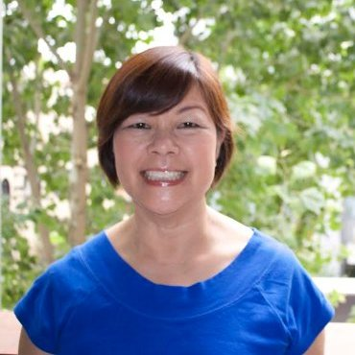
Suzie Wong
For more specialized job search prep, connect with Johnson Alumn and consultant Suzie Wong
Experience in talent acquisition at: Houzz, ebay, Google, ProMatch, HP, etc.
Suzie Wong
Technical Recruiter at Houzz
Timetrade: https://www.timetrade.com/book/8BMBQ
Timeslots:
10:30 – 11:00 EST
11:00 – 11:30 EST
11:30 – 12:00 EST
Book for 30 mins, or book with 2-3 friends and book for 60 mins
Suzie Wong
Technical Recruiter
Houzz

Slide 26
Important dates for spring 2017
KEY RESOURCES
Date | Event/Action | location
MON 2/27 | FREE Coding Bootcamp | 6:15 – 8:15pm, B05
THURS 3/2 | Johnson Thought Leader Series in NYC – The Fintech Revolution: Part II | 6:00 – 9:00pm, One Madison Avenue, Fifth Floor, NYC
FRI 3/3 | Johnson Women in Technology Conference | 9:00 – 5:30pm, Microsoft Technology Center, NYC
SAT/SUN 3/4 -3/5 | Business by Design: Using a Designer’s Mindset to Innovate and Lead (2 day, 1.5 credit LSP) | Ramin Parlor, Sat: 10:00 – 4:00pm Sun: 10:00 – 1:00pm
MON/TUES 3/6-3/7 | LendIt – Conference “The World’s Biggest Show in Lending & Fintech” | NYC Mon: 8:30 – 8:00pm Tues: 8:30 – 5:00pm
TUES 3/7 | Talent + Technology (hosted by HCA, HP Global head of Talent Acquisition) | 6:00 – 8:00pm, Sage B01
TUES 3/14 | Boston Predictions Event | Boston, 6:30 – 9:30pm
FRI 3/31 | Day by the Lake Interview Forum | Chicago, 9:00am – 5:00pm
FRI 4/7 | Day by the Lake Interview Forum | San Francisco, 7:30 – 5:00pm
WED 4/19 | The Problems of Cash and the Perils of Ceaselessness: Researching mobile money and payment infrastructure after M-Pesa | 12:20 – 1:30pm, Warren Hall 401

Slide 27
Questions?

